Slide 1
CH16 Security Protocols
ZJU 2020
Notes:
This chapter provides an overview of computer security. We begin with a discussion
of what we mean by computer security. In essence, computer security deals
with computer-related assets that are subject to a variety of threats and for which
various measures are taken to protect those assets. Accordingly, the next section of
this chapter provides a brief overview of the categories of computer-related assets
that users and system managers wish to preserve and protect, and a look at the
various threats and attacks that can be made on those assets. Then, we survey the
measures that can be taken to deal with such threats and attacks. This we do from
three different viewpoints, in Sections 1.3 through 1.5. We then lay out in general
terms a computer security strategy.
The focus of this chapter, and indeed this book, is on three fundamental
questions:
1. What assets do we need to protect?
2. How are those assets threatened?
3. What can we do to counter those threats?

Slide 2
Why Security Protocols
Alice and Bob want to communicate securely over the Internet, they need to:
(Mutually) authenticate
Establish and exchange keys
Agree to cryptographic operations and algorithms
Building blocks:
Public-key (asymmetric) and secret-key (symmetric) algorithms, hash functions
Notes:
A network protocol defines the rules and conventions for communications between two entities.
A security protocol defines the rules and conventions for SECURE communications.
What are these rules and conventions?
Suppose Alice and Bob want to communicate securely over the Internet, which is not secure. Typical, by secure communications, we mean some combination of authentication of both parties, message confidentiality, integrity, and authenticity. To accomplish these goals, we need to use the asymmetric and symmetric encryption algorithms and hash functions as building blocks, and Alice and Bob need to authenticate each other, establish and exchange keys and agree to the cryptographic operations and algorithms that they use.

Slide 3
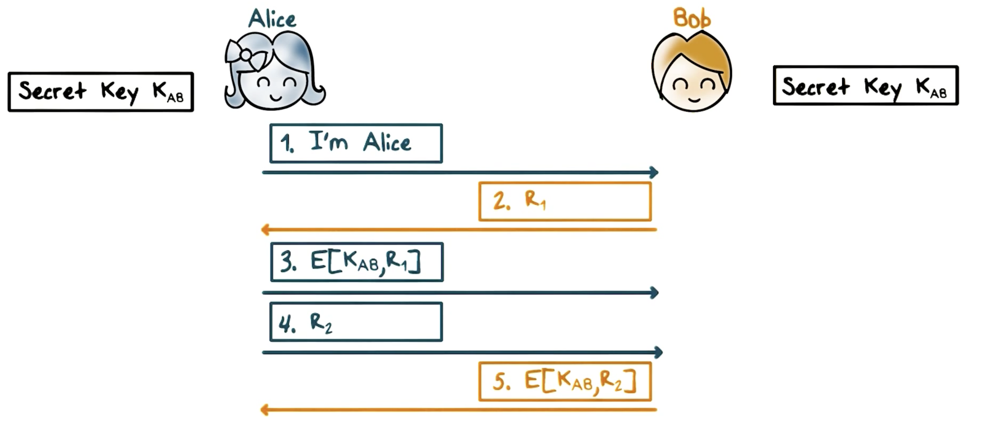
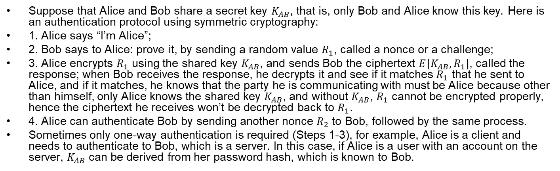
Mutual Authentication: Shared Secret
Suppose that Alice and Bob share a secret key $K_{AB}$, that is, only Bob and Alice know this key. Here is an authentication protocol using symmetric cryptography:
1. Alice says “I’m Alice”;
2. Bob says to Alice: prove it, by sending a random value $R_{1}$, called a nonce or a challenge;
3. Alice encrypts $R_{1}$ using the shared key $K_{AB}$, and sends Bob the ciphertext $E[K_{AB},R_{1}]$, called the response; when Bob receives the response, he decrypts it and see if it matches $R_{1}$ that he sent to Alice, and if it matches, he knows that the party he is communicating with must be Alice because other than himself, only Alice knows the shared key $K_{AB}$, and without $K_{AB}$, $R_{1}$ cannot be encrypted properly, hence the ciphertext he receives won’t be decrypted back to $R_{1}$.
4. Alice can authenticate Bob by sending another nonce $R_{2}$ to Bob, followed by the same process.
Sometimes only one-way authentication is required (Steps 1-3), for example, Alice is a client and needs to authenticate to Bob, which is a server. In this case, if Alice is a user with an account on the server, $K_{AB}$ can be derived from her password hash, which is known to Bob.
Notes:
Let’s take a look at authentication, that is, Alice needs to prove to Bob that she is really Alice and vice versa, Bob needs to prove to Alice that he is Bob.
4. Now it is Alice’s turn to authenticate Bob, so, similarly, she sends Bob a random challenge R_2;
Fifth, Bob encrypts R_2 with the shared key K_AB and sends the ciphertext to Alice; upon receiving the response from Bob, Alice decrypts the ciphertext if the result matches the plaintext R_2 that she sent to Bob, she knows that the party she is communicating with must be Bob.
Note that if only one-way authentication is required, for example, Alice is a client and needs to authenticate to Bob, which is a server, but Bob does not need to authenticate to Alice, then only the first three steps of the protocol are used, and if Alice is a human user, the key K_AB can be derived from her password hash, which is known to Bob.

Slide 4
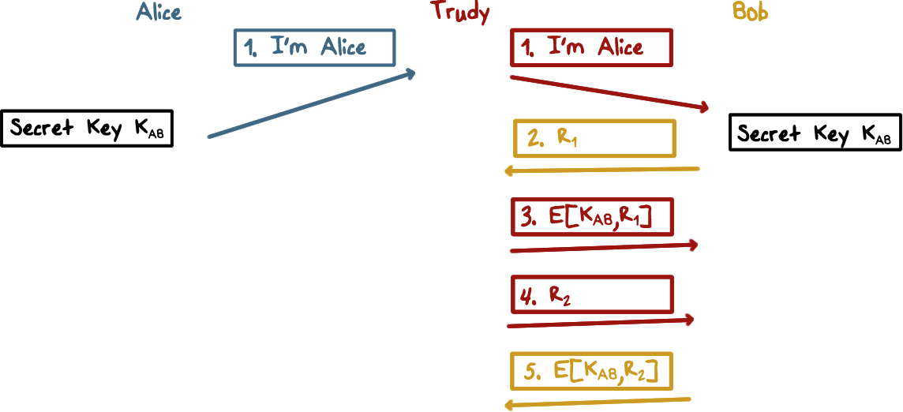
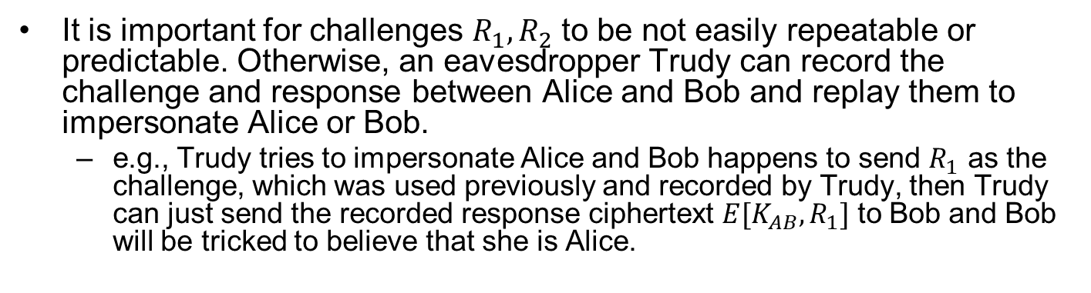
Record-and-Replay Attacks
It is important for challenges $R_{1},R_{2}$ to be not easily repeatable or predictable. Otherwise, an eavesdropper Trudy can record the challenge and response between Alice and Bob and replay them to impersonate Alice or Bob.
e.g., Trudy tries to impersonate Alice and Bob happens to send $R_{1}$ as the challenge, which was used previously and recorded by Trudy, then Trudy can just send the recorded response ciphertext $E[K_{AB},R_{1}]$ to Bob and Bob will be tricked to believe that she is Alice.

Slide 5
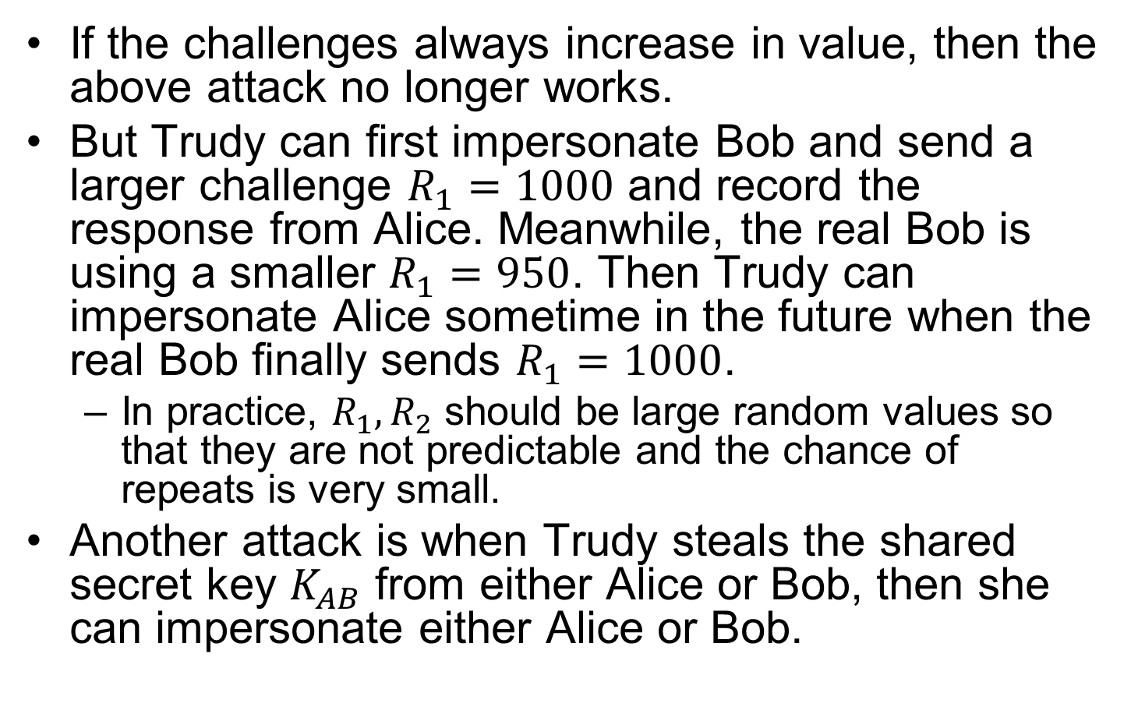
Record-and-Replay Attacks cont’d
If the challenges always increase in value, then the above attack no longer works.
But Trudy can first impersonate Bob and send a larger challenge $R_{1}=1000$ and record the response from Alice. Meanwhile, the real Bob is using a smaller $R_{1}=950$. Then Trudy can impersonate Alice sometime in the future when the real Bob finally sends $R_{1}=1000$.
In practice, $R_{1},R_{2}$ should be large random values so that they are not predictable and the chance of repeats is very small.
Another attack is when Trudy steals the shared secret key $K_{AB}$ from either Alice or Bob, then she can impersonate either Alice or Bob.
Notes:
Also, it is important for challenges R_1 and R_2 to be not easily repeatable or predictable. Otherwise, Trudy can record the challenge and response between Alice and Bob and replay them to impersonate Alice or Bob. For example, Trudy tries to impersonate Alice and Bob happens to send R_1 as the challenge, which was used previously and recorded by Trudy, then Trudy can just send the recorded response, that is, the ciphertext of R_1 to Bob and Bob will be tricked to believe that she is Alice. As another example, supposed that the challenges always increase in values. Then Trudy can first impersonate Bob and send a larger challenge R_1 = 1000 and record the response from Alice. Meanwhile, the real Bob is using a smaller R_1 = 950. Then Trudy can impersonate Alice sometime in the future when the real Bob finally sends R1=1000.

Slide 6
Mutual Authentication Quiz
Which ones are true?
The challenge values used in an authentication protocol can be repeatedly used in multiple sessions
The authentication messages can be captured and replayed by an adversary
Authentication can be one-way, e.g., only authenticating Alice to Bob
ANS: B, C.
Notes:
Solution:
1. False; 2. True; 3. True.

Slide 7
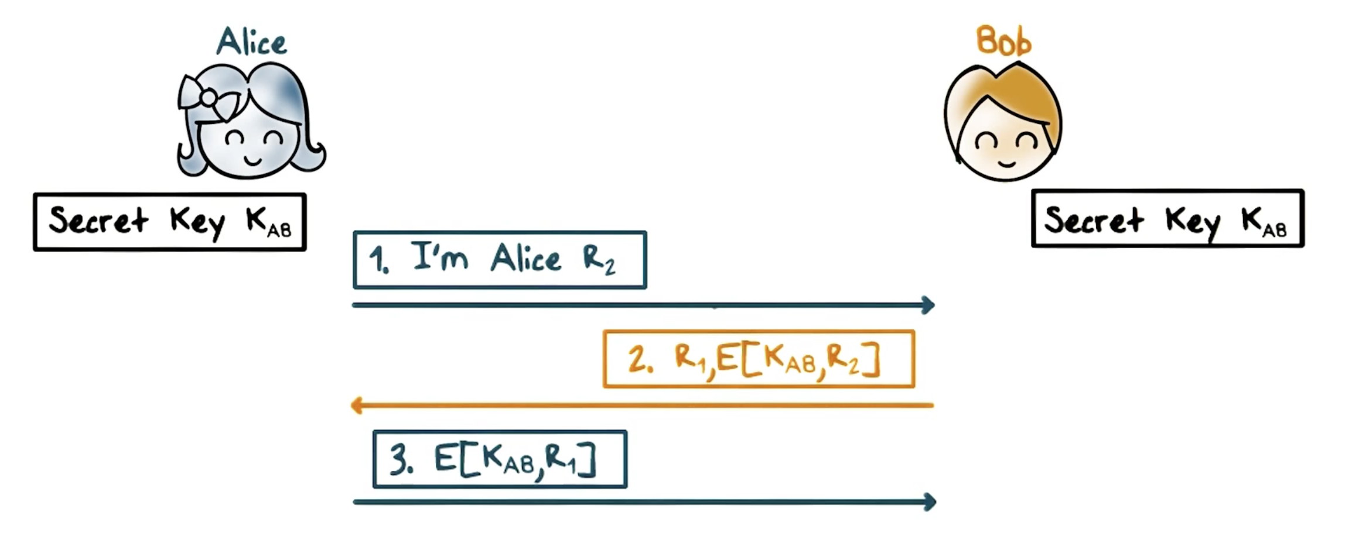
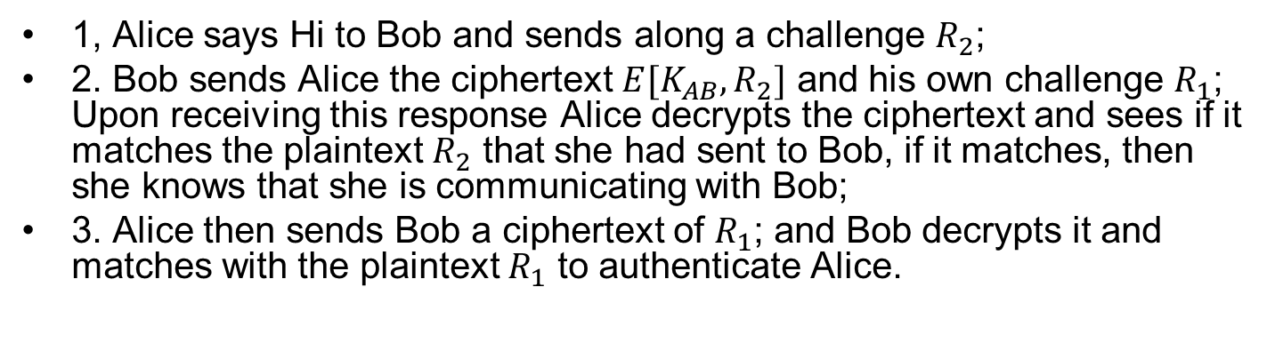
Mutual Authentication: Simplified
1, Alice says Hi to Bob and sends along a challenge $R_{2}$;
2. Bob sends Alice the ciphertext $E[K_{AB},R_{2}]$ and his own challenge $R_{1}$; Upon receiving this response Alice decrypts the ciphertext and sees if it matches the plaintext $R_{2}$ that she had sent to Bob, if it matches, then she knows that she is communicating with Bob;
3. Alice then sends Bob a ciphertext of $R_{1}$; and Bob decrypts it and matches with the plaintext $R_{1}$ to authenticate Alice.
Notes:
The mutual authentication protocol takes five steps. Can we simply it? That is, can we use fewer steps.
It seems that the following would work:
Is there anything wrong with this protocol?

Slide 8
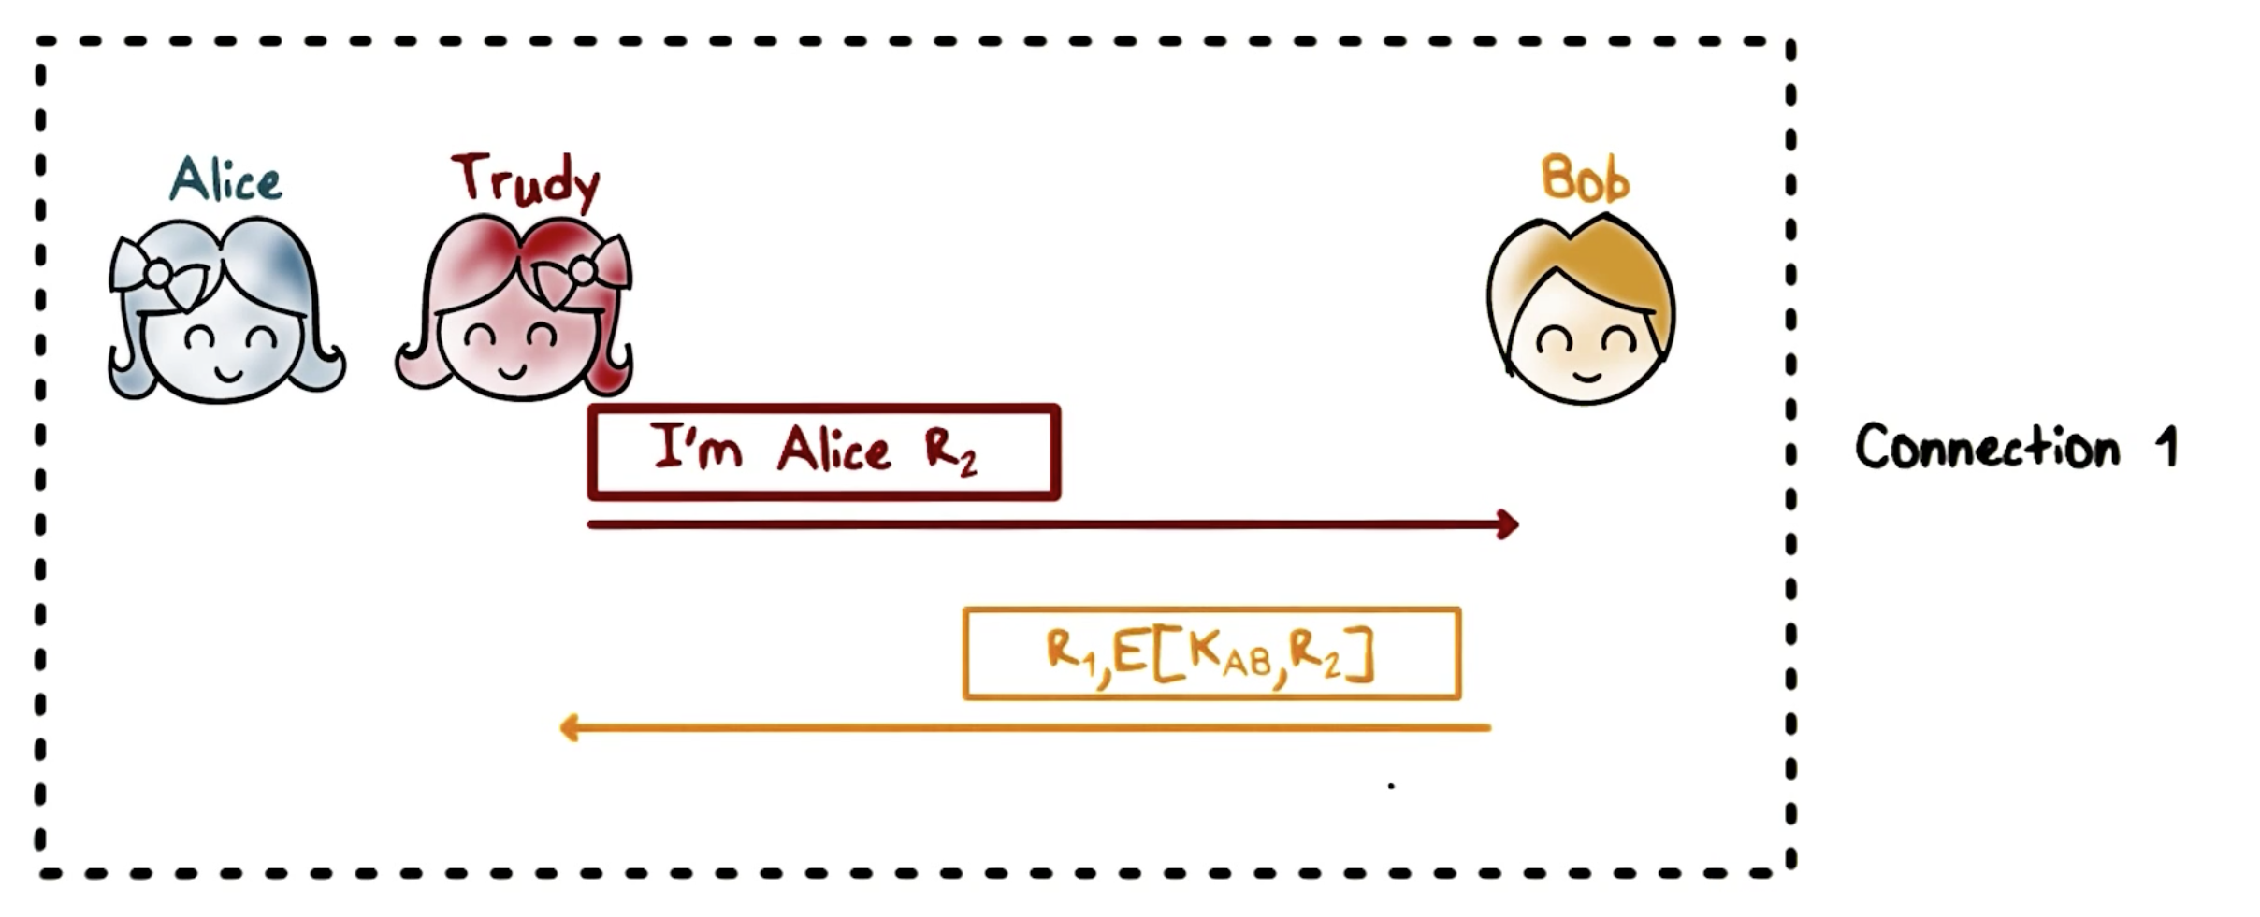
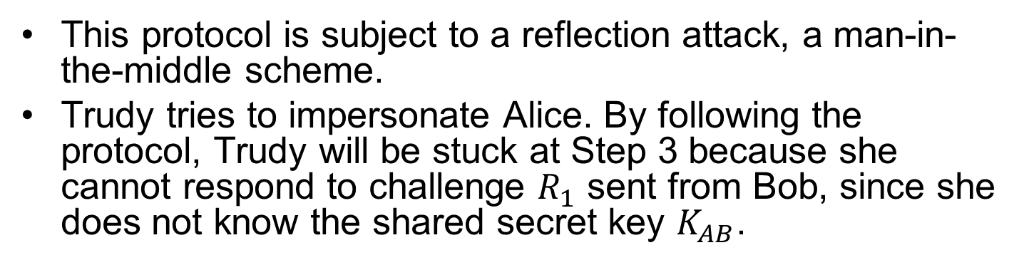
Reflection Attack
This protocol is subject to a reflection attack, a man-in-the-middle scheme.
Trudy tries to impersonate Alice. By following the protocol, Trudy will be stuck at Step 3 because she cannot respond to challenge $R_{1}$ sent from Bob, since she does not know the shared secret key $K_{AB}$.
Notes:
It turns out that there is a reflection attack, a kind of man-in-the-middle scheme.
Here is how it works:

Slide 9
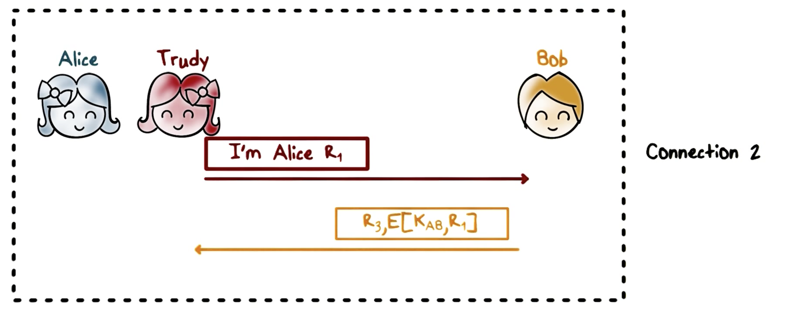
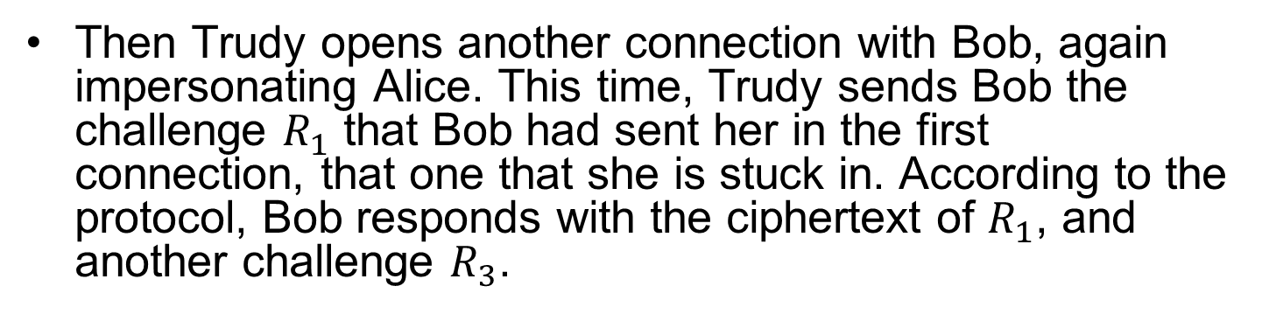
Reflection Attack
Then Trudy opens another connection with Bob, again impersonating Alice. This time, Trudy sends Bob the challenge $R_{1}$ that Bob had sent her in the first connection, that one that she is stuck in. According to the protocol, Bob responds with the ciphertext of $R_{1}$, and another challenge $R_{3}$.

Slide 10
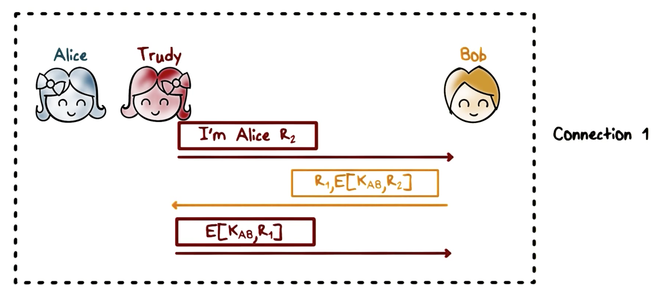
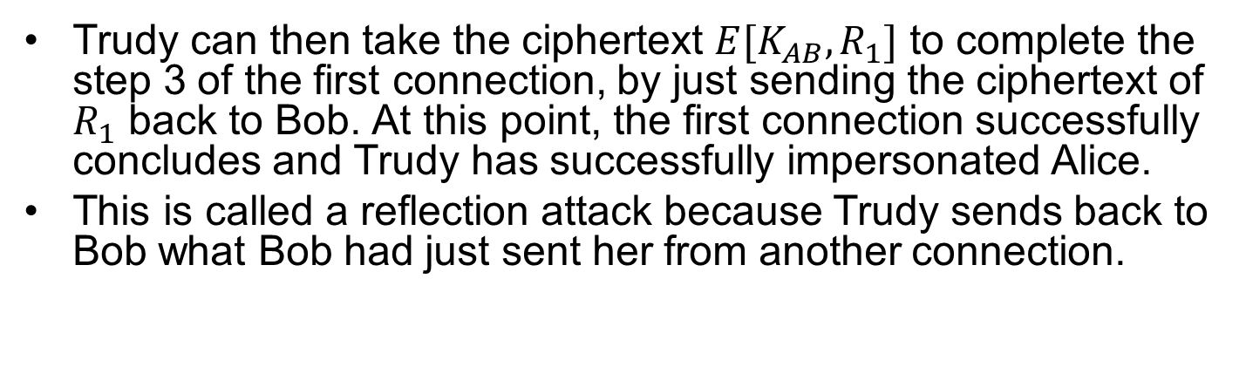
Reflection Attack
Trudy can then take the ciphertext $E[K_{AB},R_{1}]$ to complete the step 3 of the first connection, by just sending the ciphertext of $R_{1}$ back to Bob. At this point, the first connection successfully concludes and Trudy has successfully impersonated Alice.
This is called a reflection attack because Trudy sends back to Bob what Bob had just sent her from another connection.

Slide 11
Reflection Attack

Slide 12
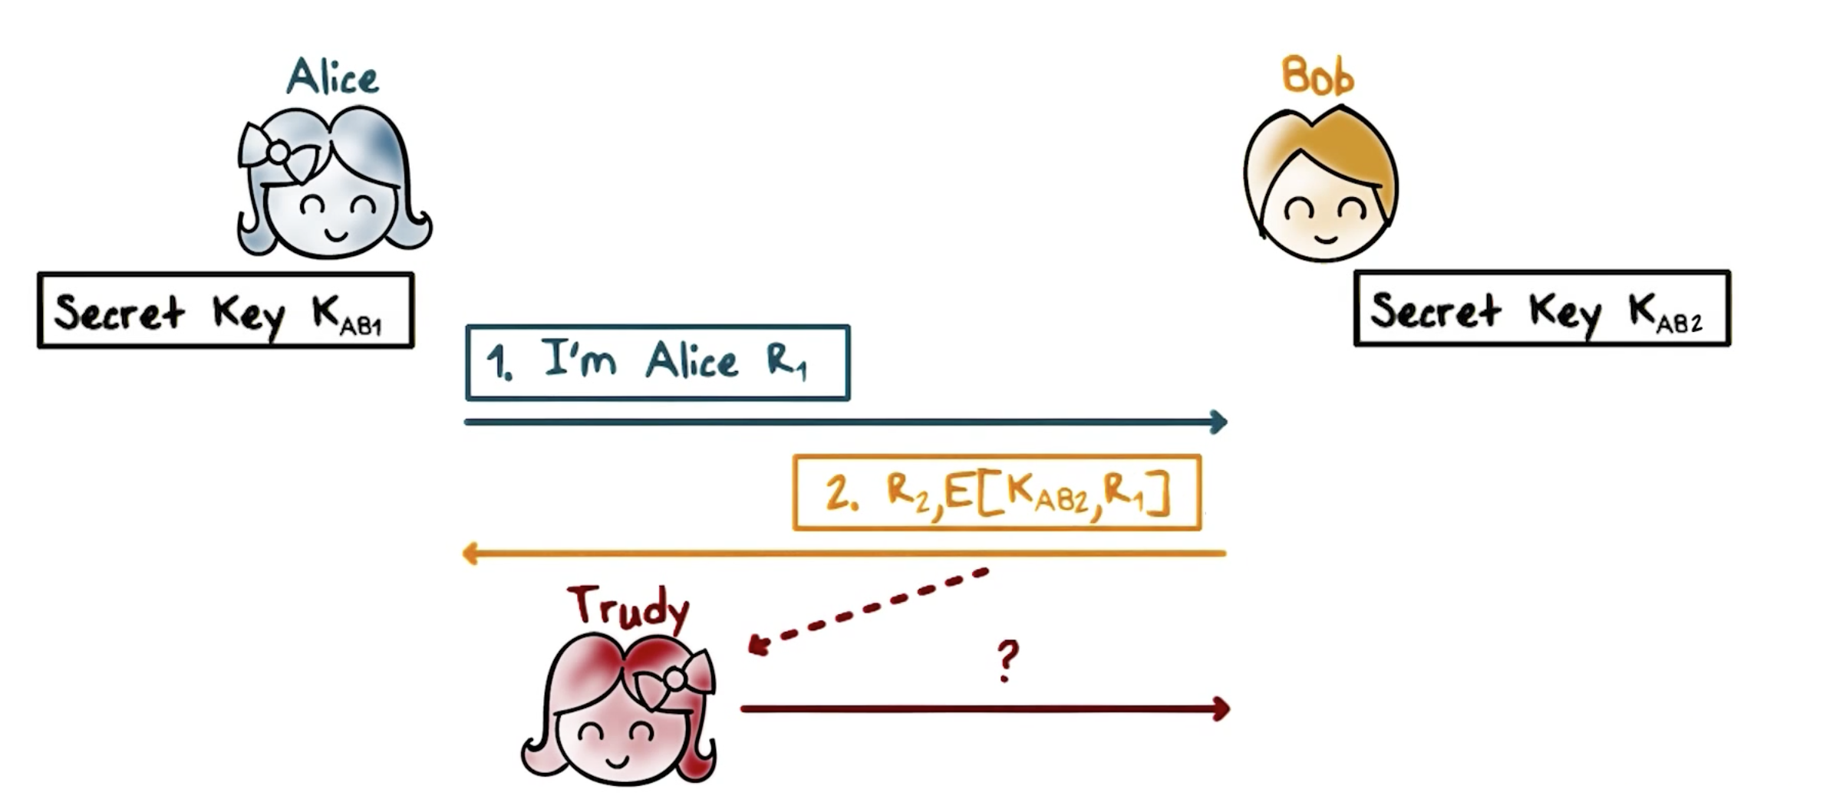
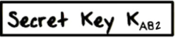
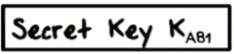
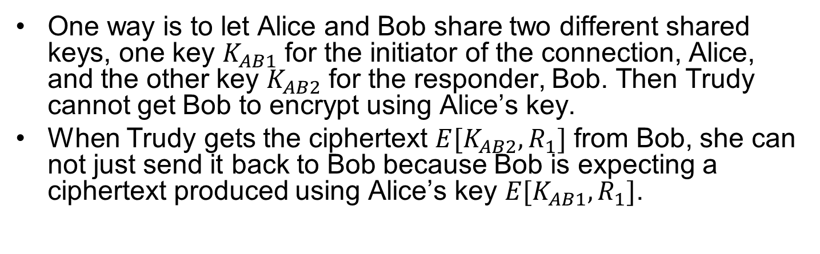
Preventing Reflection Attack
One way is to let Alice and Bob share two different shared keys, one key $K_{AB1}$ for the initiator of the connection, Alice, and the other key $K_{AB2}$ for the responder, Bob. Then Trudy cannot get Bob to encrypt using Alice’s key.
When Trudy gets the ciphertext $E[K_{AB2},R_{1}]$ from Bob, she can not just send it back to Bob because Bob is expecting a ciphertext produced using Alice’s key $E[K_{AB1},R_{1}]$.
Notes:
How can we prevent reflection attacks?
When Alice encrypts the challenge $R_{1}$, she uses $K_{AB1}$ that is different from the key $K_{AB2}$ used by Bob. Therefore, w

Slide 13
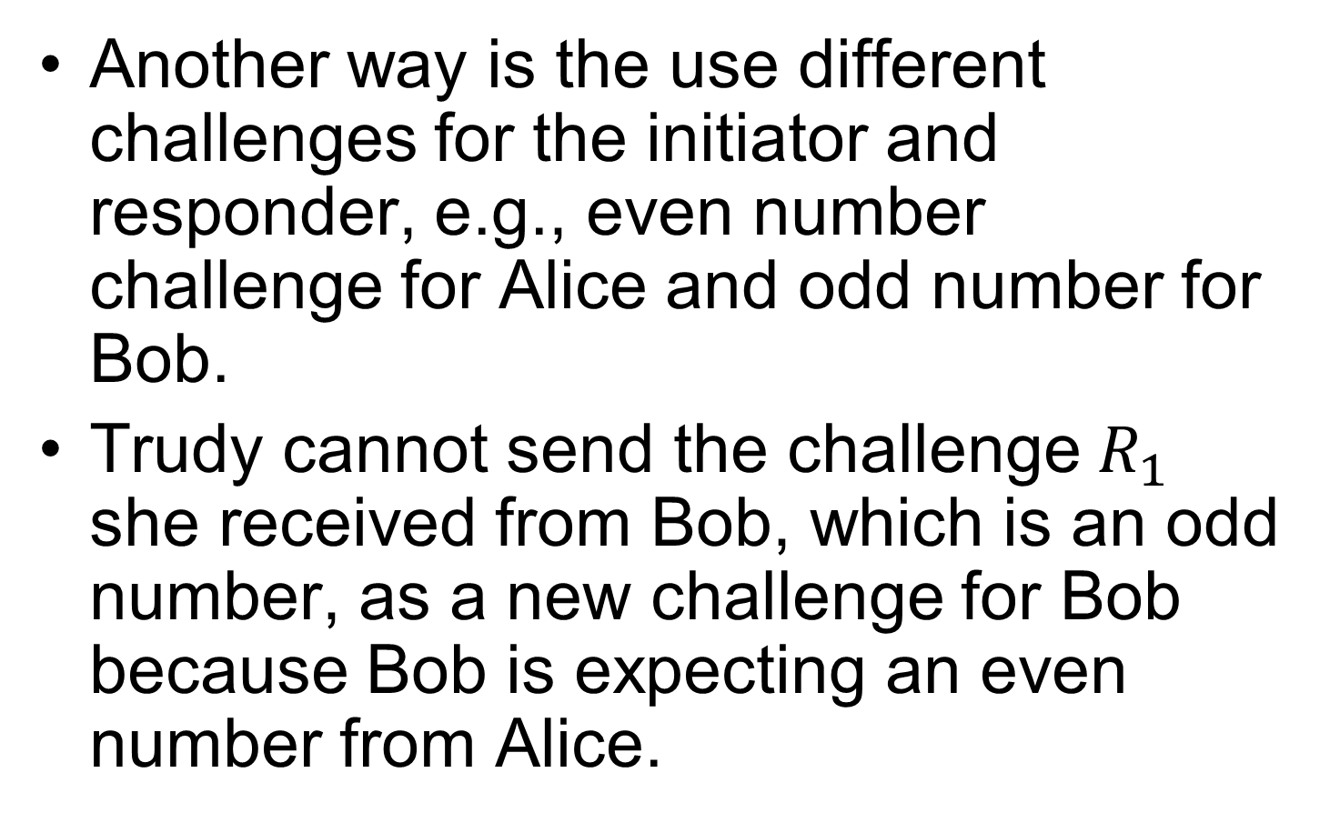
Mutual Authentication: Reflection Attack
Another way is the use different challenges for the initiator and responder, e.g., even number challenge for Alice and odd number for Bob.
Trudy cannot send the challenge $R_{1}$ she received from Bob, which is an odd number, as a new challenge for Bob because Bob is expecting an even number from Alice.

Slide 14
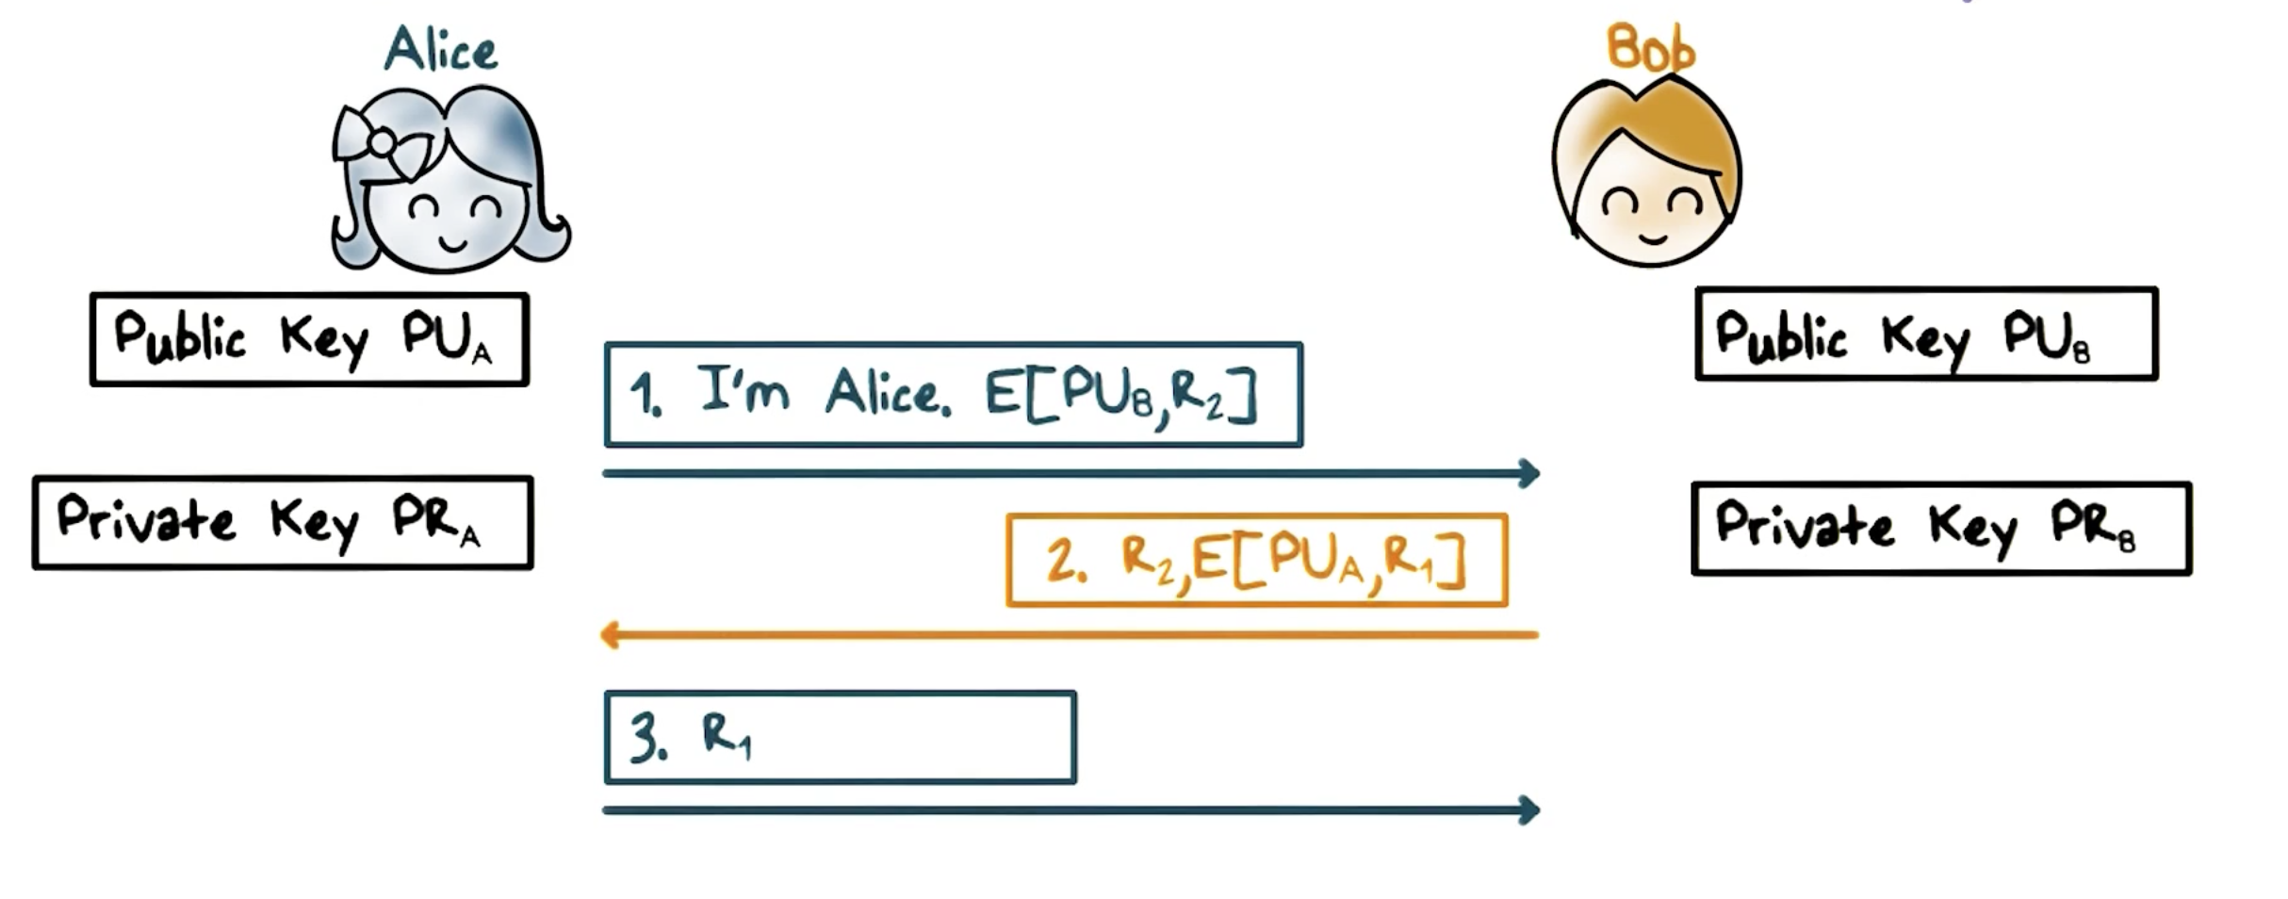
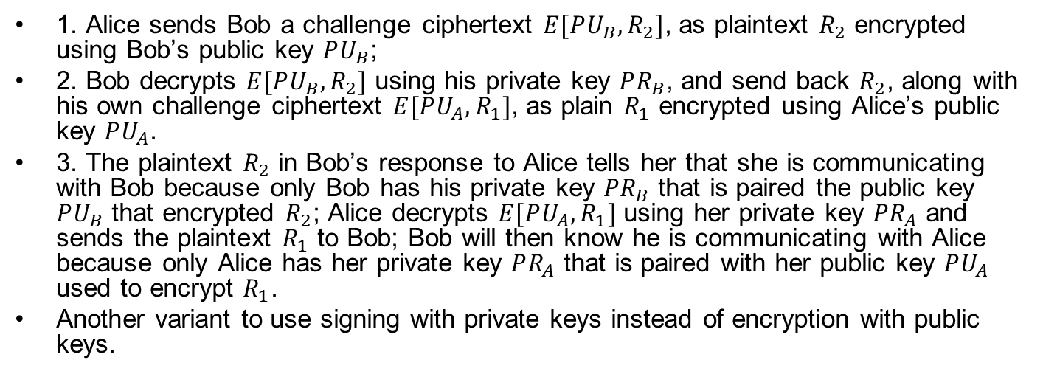
Mutual Authentication w Public Keys
1. Alice sends Bob a challenge ciphertext $E[PU_{B},R_{2}]$, as plaintext $R_{2}$ encrypted using Bob’s public key $PU_{B}$;
2. Bob decrypts $E[PU_{B},R_{2}]$ using his private key $PR_{B}$, and send back $R_{2}$, along with his own challenge ciphertext $E[PU_{A},R_{1}]$, as plain $R_{1}$ encrypted using Alice’s public key $PU_{A}$.
3. The plaintext $R_{2}$ in Bob’s response to Alice tells her that she is communicating with Bob because only Bob has his private key $PR_{B}$ that is paired the public key $PU_{B}$ that encrypted $R_{2}$; Alice decrypts $E[PU_{A},R_{1}]$ using her private key $PR_{A}$ and sends the plaintext $R_{1}$ to Bob; Bob will then know he is communicating with Alice because only Alice has her private key $PR_{A}$ that is paired with her public key $PU_{A}$ used to encrypt $R_{1}$.
Another variant to use signing with private keys instead of encryption with public keys.
Notes:
We can also use asymmetric cryptography for mutual authentication.
Suppose Alice and Bob have each other’s public key.
Here is the protocol using asymmetric cryptography:
First, Alice sends Bob a challenge R_2 that is encrypted using Bob’s public key;
Second, upon receiving this challenge, Bob decrypts the ciphertext using his private key, and send back the plaintext challenge R_2, along with his own challenge R_1 encrypted using Alice’s pbulic key.
Third, the plaintext R_2 in Bob’s response to Alice tells her that she is communicating with Bob because only Bob has the private key that is paired the public key that encrypted R_2; Alice also decrypts the the ciphertext R_1 using her private key and sends the plaintext to Bob; Bob will then know he is communicating with Alice because only Alice has the private key that is paired with public key used to encrypt R_1.
As an exercise, you can modify this protocol to use signing with private keys instead of encryption with public keys.

Slide 15
Reflection Attack Quiz
A reflection attack is a form of man-in-the-middle attack
To defeat a reflection attack, we can use an odd number as challenge from the initiator and even number from the responder.
We can use signing with public keys to achieve mutual authentication.
ANS: A, B
Notes:
Solution:
All True

Slide 16
Session Keys
Typically, Alice and Bob share a long-term secret key called the master key. For example, the master key is derived from a password. For each session, Alice and Bob use the master secret key to authenticate and establish a temporary session key to protect message security during the session.
The main benefit of using a session key is that if the key is leaked or broken, the impact is limited to the current session. Intuitively, the more a secret is used, the higher the chance that the secret can be leaked. Therefore, we should limit the use of the long-term, master secret, and only use it at the beginning of a session for authentication and establishing the session key.
Notes:
After authentication, in order to protect message security, Alice and Bob would need to establish a shared secret Session Key for the session. This is true even if Alice and Bob already has a shared secret key. Then all messages in the session are protected using
Authentication first
A new key is used for each session
Using shared (master) secret
Encrypt the new key
Using public keys
the session key Establish a shared key for the session, even if a there is already a shared secret key.
Typically a long term secret key is called a Master key, possibly derived from a password.
The master key is used to authenticate and establish a new session key.

Slide 17
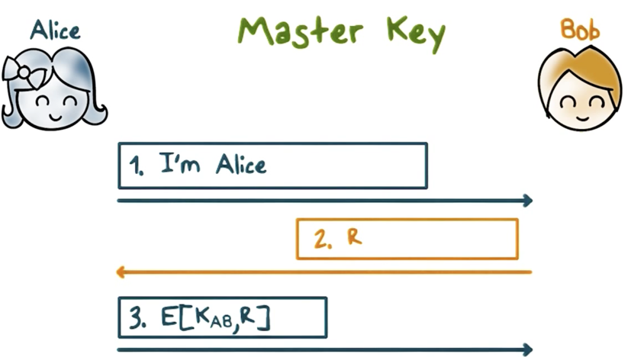
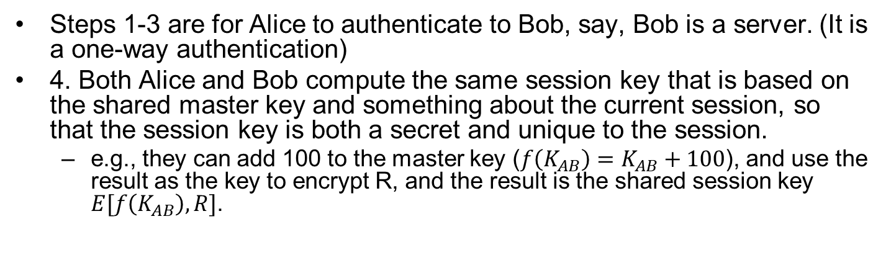
Session Key Example
Steps 1-3 are for Alice to authenticate to Bob, say, Bob is a server. (It is a one-way authentication)
4. Both Alice and Bob compute the same session key that is based on the shared master key and something about the current session, so that the session key is both a secret and unique to the session.
e.g., they can add 100 to the master key ($f\left(K_{AB}\right)=K_{AB}+100$), and use the result as the key to encrypt R, and the result is the shared session key $E[f\left(K_{AB}\right),R]$.
Notes:
Here is an example:
The first three steps are just for Alice to authenticate to Bob, say, Bob is a server.
Then both Alice and Bob compute the same session key that is based on the shared master key and something about the current session, so that the session key is both a secret and unique to the session. So, for example, they can add 100 to the master key, and use the result as the key to encrypt R, and the result is the shared session key.

Slide 18
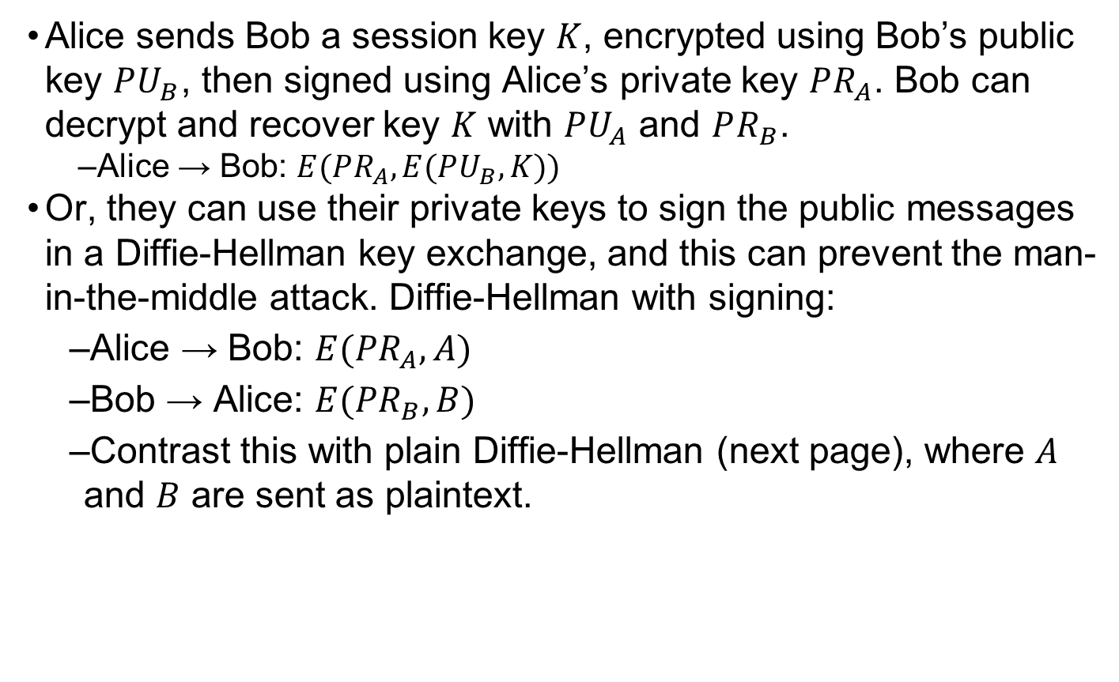
Exchanging Session Key w. Public Keys
Alice sends Bob a session key $K$, encrypted using Bob’s public key $PU_{B}$, then signed using Alice’s private key $PR_{A}$. Bob can decrypt and recover key $K$ with $PU_{A}$ and $PR_{B}$.
Alice → Bob: $E(PR_{A}, E(PU_{B}, K))$
Or, they can use their private keys to sign the public messages in a Diffie-Hellman key exchange, and this can prevent the man-in-the-middle attack. Diffie-Hellman with signing:
Alice → Bob: $E(PR_{A}, A)$
Bob → Alice: $E(PR_{B}, B)$
Contrast this with plain Diffie-Hellman (next page), where $A$ and $B$ are sent as plaintext.
Notes:
https://security.stackexchange.com/questions/73114/authenticated-diffie-hellman-key-exchange
Alice and Bob can also use their public keys to exchange a shared session key.
For example, Alice can send Bob a key, encrypted using Bob’s public key, so that only Bob can decrypt and get the key. and then sign the result using Alice’s private key so that Bob knows that key is sent by Alice.
Or, they can use their private keys to sign the public messages in a Diffie-Hellman key exchange, and this can prevent the man-in-the-middle attack.

Slide 19
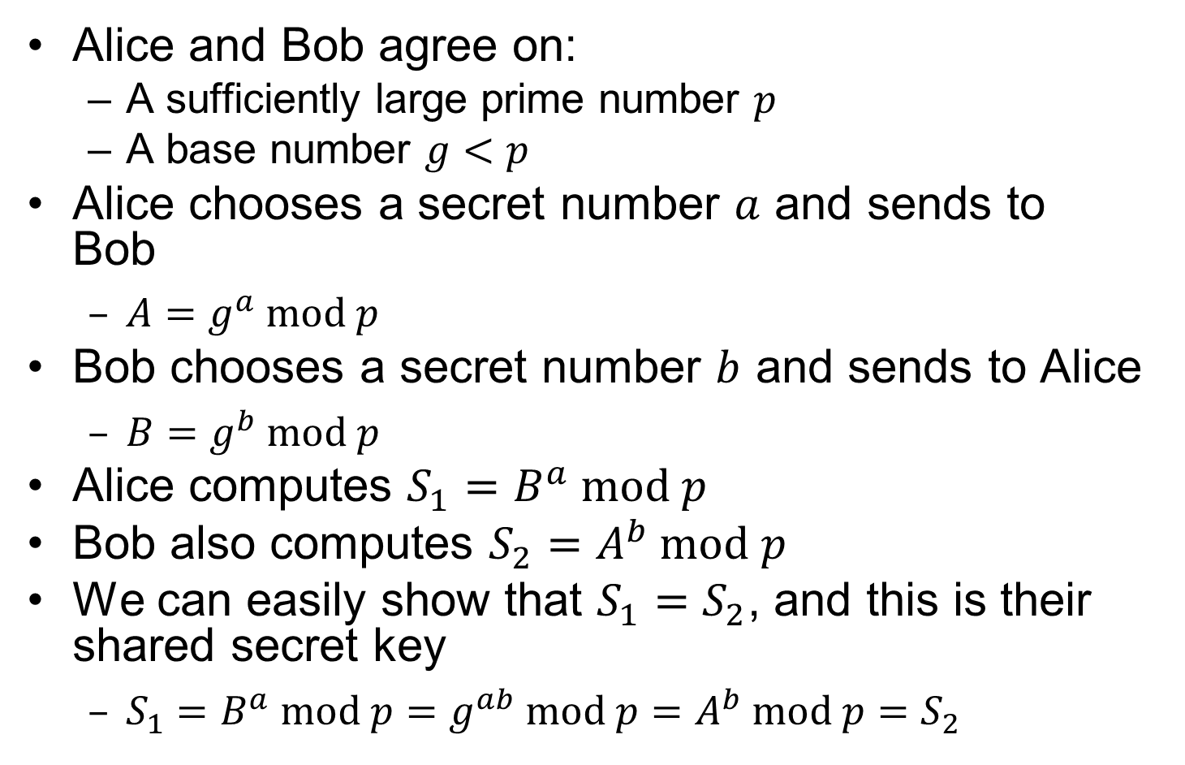
Recall: Diffie-Hellman
Alice and Bob agree on:
A sufficiently large prime number $p$
A base number $g<p$
Alice chooses a secret number $a$ and sends to Bob
$A=g^{a} mod p$
Bob chooses a secret number $b$ and sends to Alice
$B=g^{b} mod p$
Alice computes $S_{1}=B^{a} mod p$
Bob also computes $S_{2}=A^{b} mod p$
We can easily show that $S_{1}=S_{2}$, and this is their shared secret key
$S_{1}=B^{a} mod p=g^{ab} mod p=A^{b} mod p=S_{2}$
Notes:
Public Key Generation
$A,B,p,g$ are all public; only $A$ knows secret $a$; only $B$ knows secret $b$.

Slide 20
Key Distribution Center (KDC)
Pairwise key-exchange based on shared secret master key does not scale to large number of parties, since each communication pair needs to share a master key
Alice needs to share a master key with Bob, another master key with Carol, and so on.
This motivates KDC.
Notes:
One shortcoming of pairwise key-exchange based on shared secret master key is that it does not scale easily. That is, Alice needs to share a master with Bob, another master with Carol, so on and so forth.

Slide 21
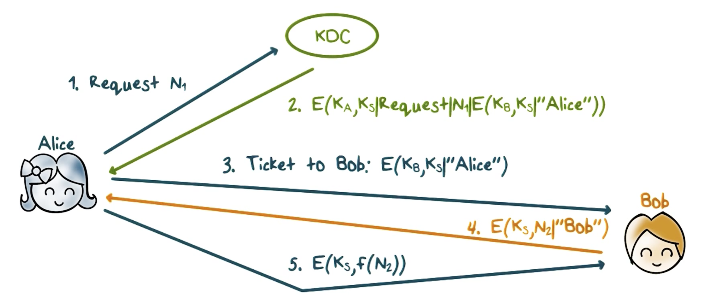
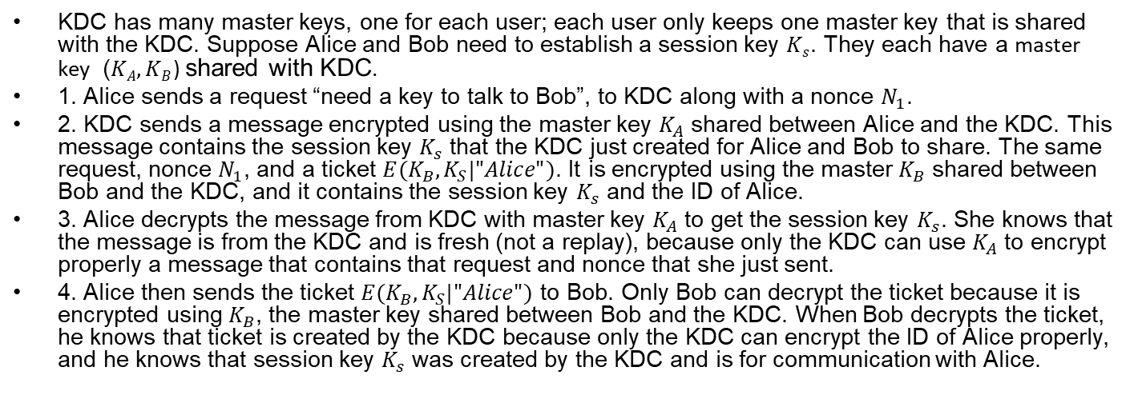
Key Distribution Center (KDC)
KDC has many master keys, one for each user; each user only keeps one master key that is shared with the KDC. Suppose Alice and Bob need to establish a session key $Ks$. They each have a master key ($KA, KB$) shared with KDC.
1. Alice sends a request “need a key to talk to Bob”, to KDC along with a nonce $N_{1}$.
2. KDC sends a message encrypted using the master key $K_{A}$ shared between Alice and the KDC. This message contains the session key $K_{s}$ that the KDC just created for Alice and Bob to share. The same request, nonce $N_{1}$, and a ticket $E(K_{B},K_{S}|"Alice")$. It is encrypted using the master $K_{B}$ shared between Bob and the KDC, and it contains the session key $K_{s}$ and the ID of Alice.
3. Alice decrypts the message from KDC with master key $K_{A}$ to get the session key $K_{s}$. She knows that the message is from the KDC and is fresh (not a replay), because only the KDC can use $K_{A}$ to encrypt properly a message that contains that request and nonce that she just sent.
4. Alice then sends the ticket $E(K_{B},K_{S}|"Alice")$ to Bob. Only Bob can decrypt the ticket because it is encrypted using $K_{B}$, the master key shared between Bob and the KDC. When Bob decrypts the ticket, he knows that ticket is created by the KDC because only the KDC can encrypt the ID of Alice properly, and he knows that session key $K_{s}$ was created by the KDC and is for communication with Alice.
Notes:
, a “random number used once”
Using a key distribution center can solve this scalability problem. Each user has his or her own master key with the KDC. That is, KDC has many master keys, one for each user, but each user only keeps one master key that is shared with the KDC.
---
Now, suppose that Alice and Bob need to establish a session key,
First, Alice sends a request to KDC, such as “need a key to talk to Bob”, along with a nonce N_1, which is a random value.
Then the KDC sends a message that is encrypted using the master key K_A that is shared between Alice and the KDC. This message contains the session key K_s that the KDC just created for Alice and Bob to share. The same request, nonce N_1, and a message, is called a ticket. The ticket is encrypted using the master K_B that is shared between Bob and the KDC, and it contains the session key K_s and the ID of Alice.
---
When Alice gets back the message from the KDC, she can decrypt it because she has the master key K_A, and so she can get the session key K_s, she knows that the message is from the KDC and is fresh, that is, it is not a replay, because only the KDC can use K_A to encrypt properly a message that contains that request and nonce that she just sent.
Alice then sends the ticket to Bob. Note that only Bob can decrypt the ticket because it is encrypted using K_B, the master key shared between Bob and the KDC. In fact, when Bob decrypts the ticket, he knows that ticket is created by the KDC because only the KDC can encrypt the ID of Alice properly, and he knows that session key K_s was created by the KDC and is for communication with Alice.
----
Then Bob sends a message that contains a nonce N_2 and his ID, encrypted using the session key K_s, to Alice. When Alice receives this message she knows that she is communicating with Bob because only he can decrypt the ticket, get the key K_s and encrypt the ID properly. Alice then performs an agreed-upon transformation on N_2, say, add 100 to N_2, encrypts the result using K_s and sends it to Bob. This proves to Bob that he is communicating with Alice because only she has the session key K_s.

Slide 22
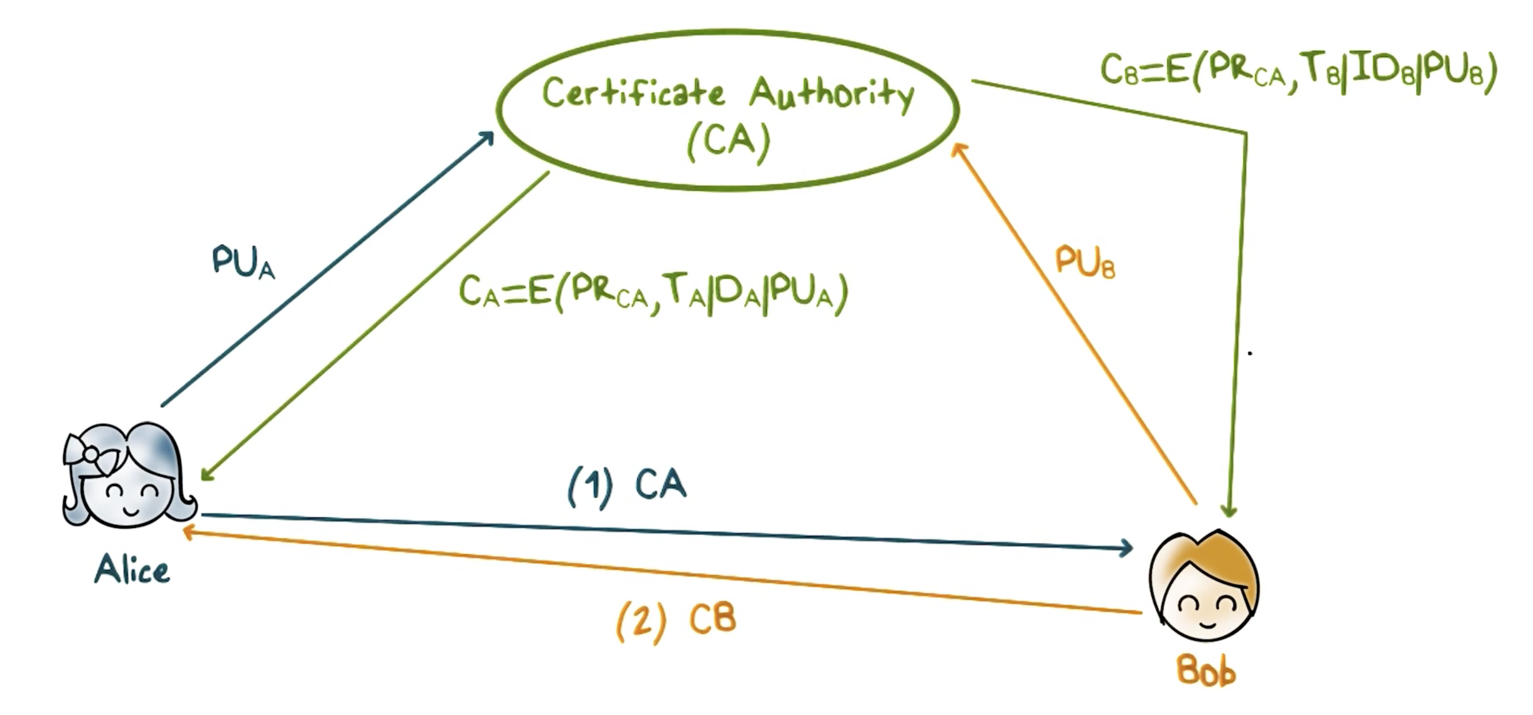
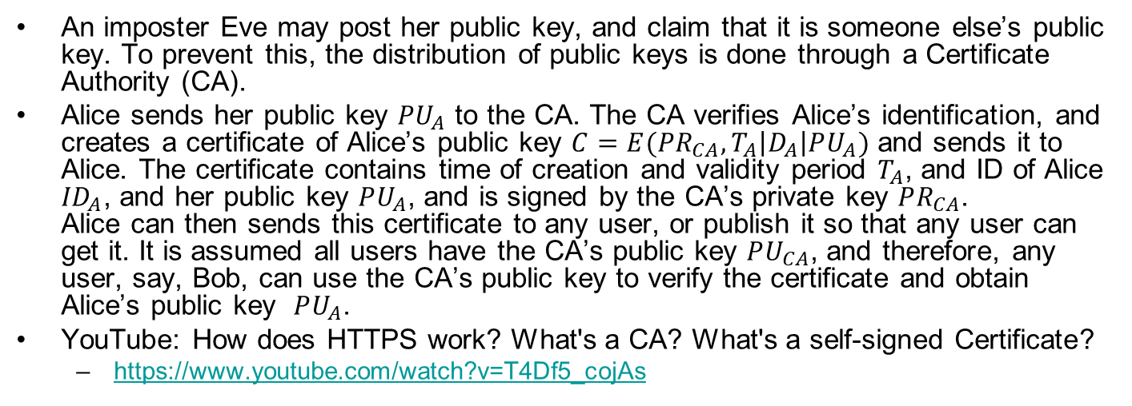
Public Key Certificates
An imposter Eve may post her public key, and claim that it is someone else’s public key. To prevent this, the distribution of public keys is done through a Certificate Authority (CA).
Alice sends her public key $PU_{A}$ to the CA. The CA verifies Alice’s identification, and creates a certificate of Alice’s public key $C=E(PR_{CA},T_{A}\left|D_{A}\right|PU_{A})$ and sends it to Alice. The certificate contains time of creation and validity period $T_{A}$, and ID of Alice ${ID}_{A}$, and her public key $PU_{A}$, and is signed by the CA’s private key $PR_{CA}$. Alice can then sends this certificate to any user, or publish it so that any user can get it. It is assumed all users have the CA’s public key $PU_{CA}$, and therefore, any user, say, Bob, can use the CA’s public key to verify the certificate and obtain Alice’s public key $PU_{A}$.
YouTube: How does HTTPS work? What's a CA? What's a self-signed Certificate?
https://www.youtube.com/watch?v=T4Df5_cojAs
Notes:
Likewise, Bob can get his certificate and send it to Alice so that she has his public key.

Slide 23
Session Key Quiz
Which items are true?
A session key should be a secret and unique to the session.
Authentication should be accomplished before key exchange.
A key benefit of using of KDC is for scalability.
In order for Bob to verify Alice’s public key, the Certificate Authority must be on-line.
In order for Bob and Alice to establish a session key, the KDC must be on-line.
Signing the message exchanges in Diffie-Hellman eliminates the man-in-the-middle attack.
ANS: A, B, C, E, F.
Notes:
Solution:
1. T; 2 T; 3 T; 4 F; 5 T.

Slide 24
Kerberos
A standard protocol for authentication and key distribution in a network environment
Every principal (a human user or a network resource such as workstation and printer) has a master (secret) key shared with the Kerberos server (referred to as KDC)
A user’s master key is derived from password
Other resources must have their keys configured in by the device manufacturer
All master keys are stored at the KDC, protected/encrypted
Notes:
Now let’s take a look how the principles of authentication and key exchange that we have discussed are used in actual systems.
Kerberos is standard protocol used to provide authentication and access control in a network environment, typically an enterprise network.
Every entity in the network, that is, all users and network resources such as workstations and printers have a master key that it shares with the Kerberos servers, which perform both authentication and key distribution. So for convenience, we use KDC to refer to a Kerberos server.
For a human user, the master key is derived from his or her password, for a network device, the key is configured in.
All the keys are stored securely at the KDC.

Slide 25
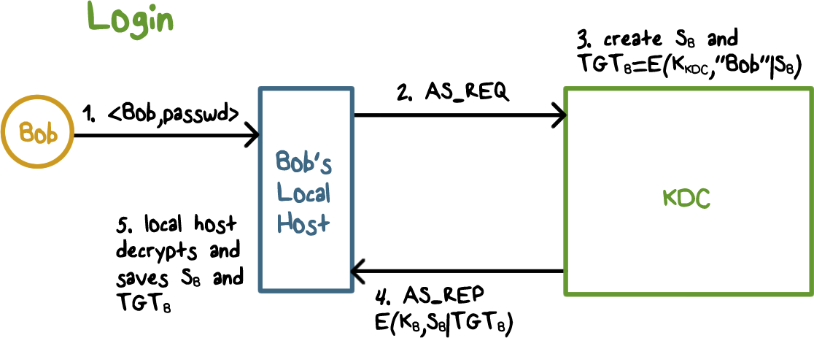
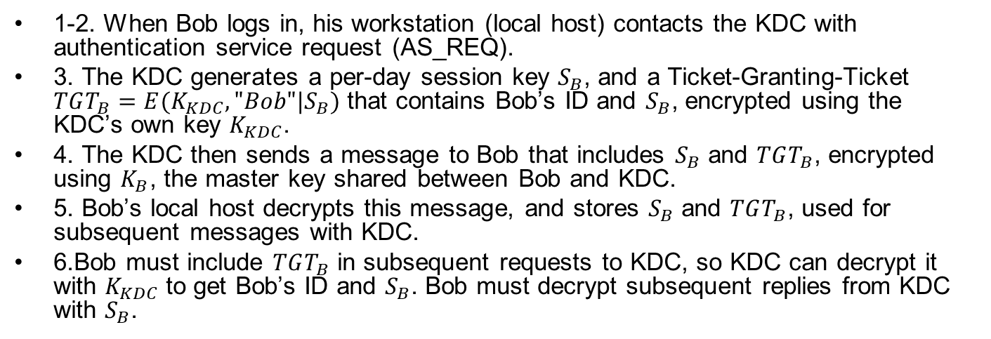
Kerberos
1-2. When Bob logs in, his workstation (local host) contacts the KDC with authentication service request (AS_REQ).
3. The KDC generates a per-day session key $S_{B}$, and a Ticket-Granting-Ticket $TGT_{B}=E(K_{KDC},"Bob"|S_{B})$ that contains Bob’s ID and $S_{B}$, encrypted using the KDC’s own key $K_{KDC}$.
4. The KDC then sends a message to Bob that includes $S_{B}$ and $TGT_{B}$, encrypted using $K_{B}$, the master key shared between Bob and KDC.
5. Bob’s local host decrypts this message, and stores $S_{B}$ and $TGT_{B}$, used for subsequent messages with KDC.
6.Bob must include $TGT_{B}$ in subsequent requests to KDC, so KDC can decrypt it with $K_{KDC}$ to get Bob’s ID and $S_{B}$. Bob must decrypt subsequent replies from KDC with $S_{B}$.
Notes:
Let’s go over a few typical Kerberos scenarios.
When user Bob logs in, his workstation contacts the KDC with a authentication service request (AS_REQ). The KDC generates a per-day session key S_B, and a so-called ticket-granting-ticket that contains S_B and the ID of Bob, and the ticket is encrypted using the KDC’s own key. The KDC then sends a message that include the per-day session key S_B and the TGT_B, encrypted using the key K_B to Bob. Because K_B is the master key shared between Bob and KDC, only Bob’s local host can decrypt this message, and stores the per-day session key S_B and TGT_B.
Bob’s local host uses S_{B}, for subsequent message with KDC, and uses TGT_B, for reminding/convincing KDC to use S_{B} with it as well. That is, New request to KDC must include TGT in the request message and new tickets from KDC must be decrypted with S_{B}

Slide 26
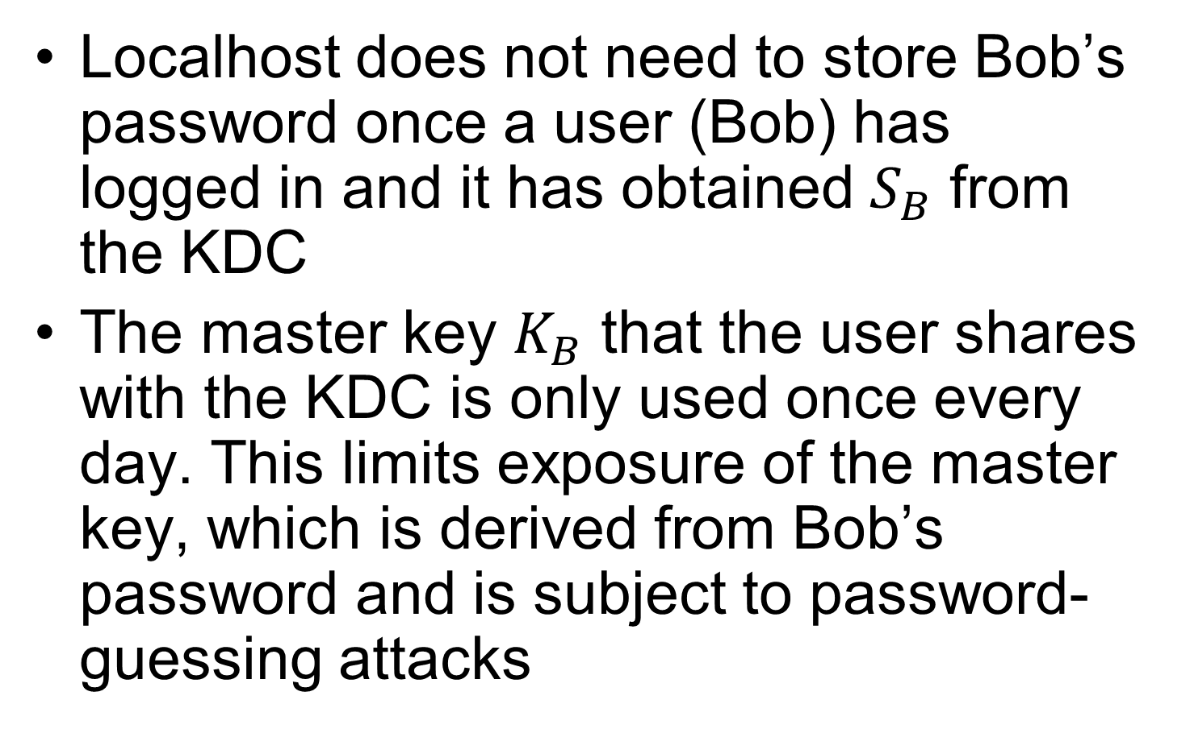
Kerberos Benefits
Localhost does not need to store Bob’s password once a user (Bob) has logged in and it has obtained $S_{B}$ from the KDC
The master key $K_{B}$ that the user shares with the KDC is only used once every day. This limits exposure of the master key, which is derived from Bob’s password and is subject to password-guessing attacks
Notes:
This has several benefits. First, the local host does not need to store Bob’s password once Bob has logged in and it has obtained S_B from the KDC. Second, the master key K_B that Bob shares with the KDC is only used once every day when Bob logs in. That is the exposure of the master key, which is derived from Bob’s password and is subject to password-guessing attacks, is limited.

Slide 27
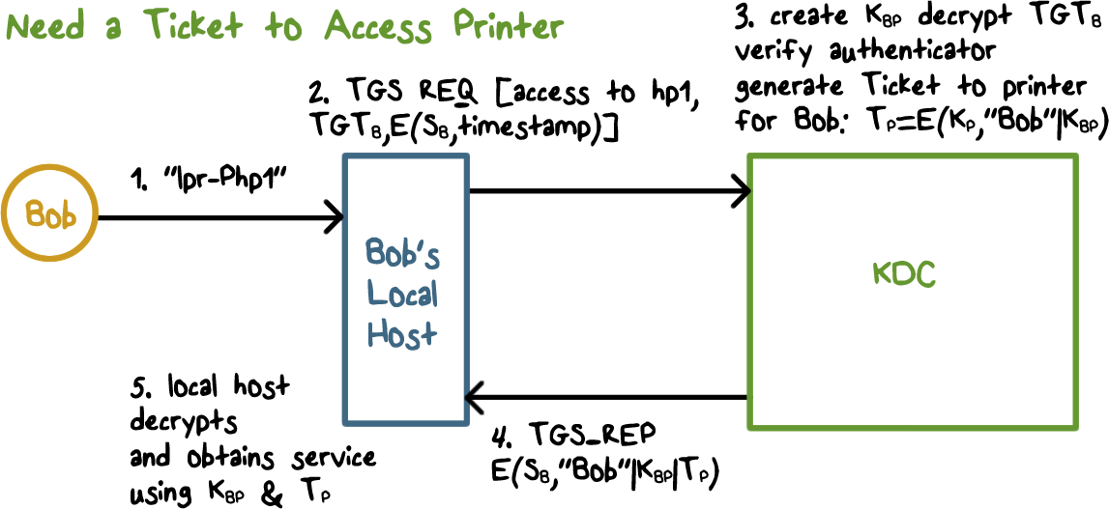
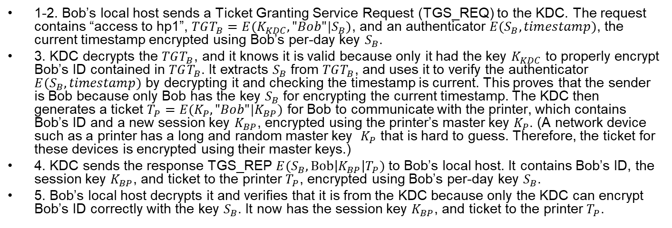
Getting a Ticket to Access the Printer
1-2. Bob’s local host sends a Ticket Granting Service Request (TGS_REQ) to the KDC. The request contains “access to hp1”, $TGT_{B}=E(K_{KDC},"Bob"|S_{B})$, and an authenticator $E(S_{B},timestamp)$, the current timestamp encrypted using Bob’s per-day key $S_{B}$.
3. KDC decrypts the $TGT_{B}$, and it knows it is valid because only it had the key $K_{KDC}$ to properly encrypt Bob’s ID contained in $TGT_{B}$. It extracts $S_{B}$ from $TGT_{B}$, and uses it to verify the authenticator $E(S_{B},timestamp)$ by decrypting it and checking the timestamp is current. This proves that the sender is Bob because only Bob has the key $S_{B}$ for encrypting the current timestamp. The KDC then generates a ticket $T_{P}=E(K_{P},"Bob"|K_{BP})$ for Bob to communicate with the printer, which contains Bob’s ID and a new session key $K_{BP}$, encrypted using the printer’s master key $K_{P}$. (A network device such as a printer has a long and random master key $K_{P}$ that is hard to guess. Therefore, the ticket for these devices is encrypted using their master keys.)
4. KDC sends the response TGS_REP $E(S_{B},\text{Bob}\left|K_{BP}\right|T_{P})$ to Bob’s local host. It contains Bob’s ID, the session key $K_{BP}$, and ticket to the printer $T_{P}$, encrypted using Bob’s per-day key $S_{B}$.
5. Bob’s local host decrypts it and verifies that it is from the KDC because only the KDC can encrypt Bob’s ID correctly with the key $S_{B}$. It now has the session key $K_{BP}$, and ticket to the printer $T_{P}$.
Notes:
Now suppose Bob wants to access the printer hp1.
His local host sends a ticket granting service request (TGS_REQ) to the KDC. The request contains the TGT_B and and authenticator, which is the current timestamp encrypted using Bob’s per-day key S_B.
When the KDC gets this request, it can decrypt the TGT_B, it knows it is an valid TGT because only it has the key to properly encrypt the ID of Bob contained in the TGT, it then uses the S_B contained in the TGT to verify the authenticator by decrypting it and check the timestamp is current. This proves that the sender is Bob because only Bob has the key S_B that can encrypt the current timestamp properly. The KDC then generates a ticket for Bob to communicate with the printer. It contains a session key K_BP, and Bob’s ID, and is encrypted using the printer’s master key. Note that a network device such as a printer has a long and random master key that is configured in, and it is typically hard to guess or crack. Therefore, the ticket for these devices is encrypted using their master keys.

Slide 28
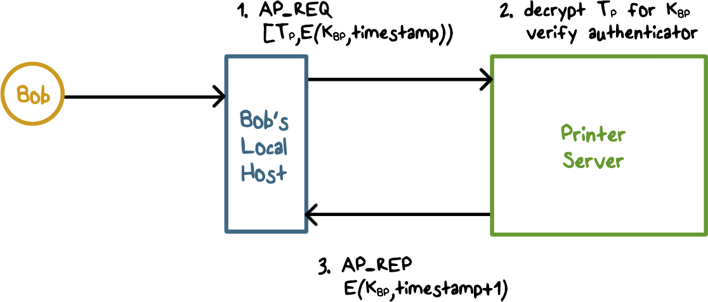
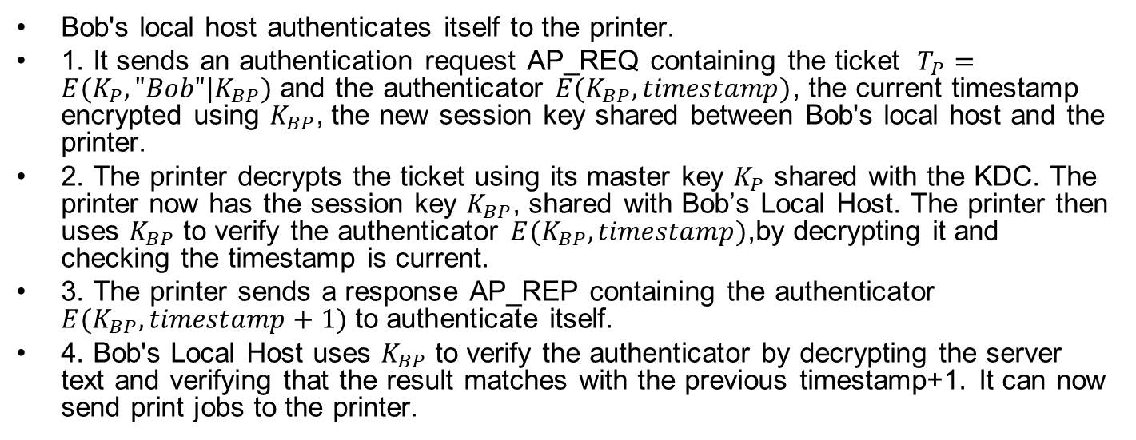
Accessing the Printer
Bob's local host authenticates itself to the printer.
1. It sends an authentication request AP_REQ containing the ticket $T_{P}=E(K_{P},"Bob"|K_{BP})$ and the authenticator $E(K_{BP},timestamp)$, the current timestamp encrypted using $K_{BP}$, the new session key shared between Bob's local host and the printer.
2. The printer decrypts the ticket using its master key $K_{P}$ shared with the KDC. The printer now has the session key $K_{BP}$, shared with Bob’s Local Host. The printer then uses $K_{BP}$ to verify the authenticator $E(K_{BP},timestamp)$,by decrypting it and checking the timestamp is current.
3. The printer sends a response AP_REP containing the authenticator $E(K_{BP},timestamp+1)$ to authenticate itself.
4. Bob's Local Host uses $K_{BP}$ to verify the authenticator by decrypting the server text and verifying that the result matches with the previous timestamp+1. It can now send print jobs to the printer.
Notes:
Because the ticket was created by the KDC. And it was encrypted using the share key between the printer and the KDC.

Slide 29
Kerberos Quiz
Which ones are true?
Kerberos provides authentication and access control
Kerberos distributes session keys
To avoid over-exposure of a user’s master key, Kerberos uses a per-day key and a ticket-granting-ticket
The authenticators used in requests to KDC and application servers can be omitted
Access to any network resource requires a ticket issued by the KDC
ANS: A,B,C,E
Notes:
Solution:
1. T; 2 T; 3 T; 4 F; 5 T.

Slide 30
Summary
One-way and mutual authentication protocols using secret key or public keys. It is important that the challenges are randomly generated to prevent record-and-replay attacks.
Protocols to establish session key, which can use pre-shared key or public keys and the random challenge used in authentication. Key Distribution Center (KDC) is often used to establishing and distributing session keys, and certificate authority is used to generate and sign public key certificate that can be distributed and verified.
Kerberos is used for authenticating users and devices on a network and enforce access control. Each access requires a ticket, and a Ticket-Granting Ticket (TGT) after user login is used to request such tickets to access devices.
Notes:
In this lecture, we have discussed one-way and mutual authentication protocols using secret key or public keys. It is important that the challenges are randomly generated, and carefully consider the possibility of attackers capturing the challenge-and-response and launch impersonation attacks.
We have also discussed protocols to establish session key, which can use pre-shared key or public keys and the random challenge used in authentication. Key distribution center is often used to establishing and distributing session keys, and certificate authority is used to generate and sign public key certificate that can be distributed and verified.
Kerberos system is used for authenticating users and devices on a network and enforce access control. Each access requires a ticket, and a ticket-granting ticket after user login is used to request such tickets to access devices.
Establish session key based on pre-shared secret key or public keys and authentication exchanges, use KDC or CA
Kerberos: authentication and access control, tickets, and ticket-granting ticket.

